Slide 1




ROOT CAUSE ANALYSIS
UNDERGROUND ASSET STRIKES
AUSTRALIA 2025
Otre Moussa

Slide 2
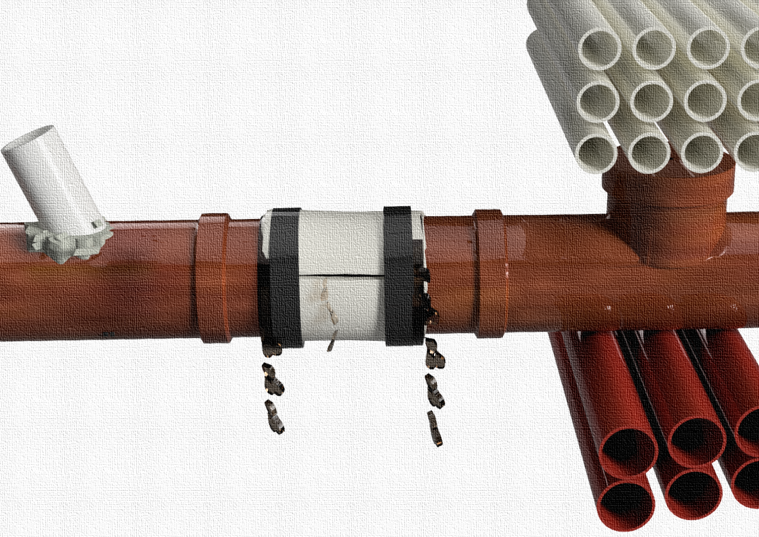

INTRODUCTION

Slide 3
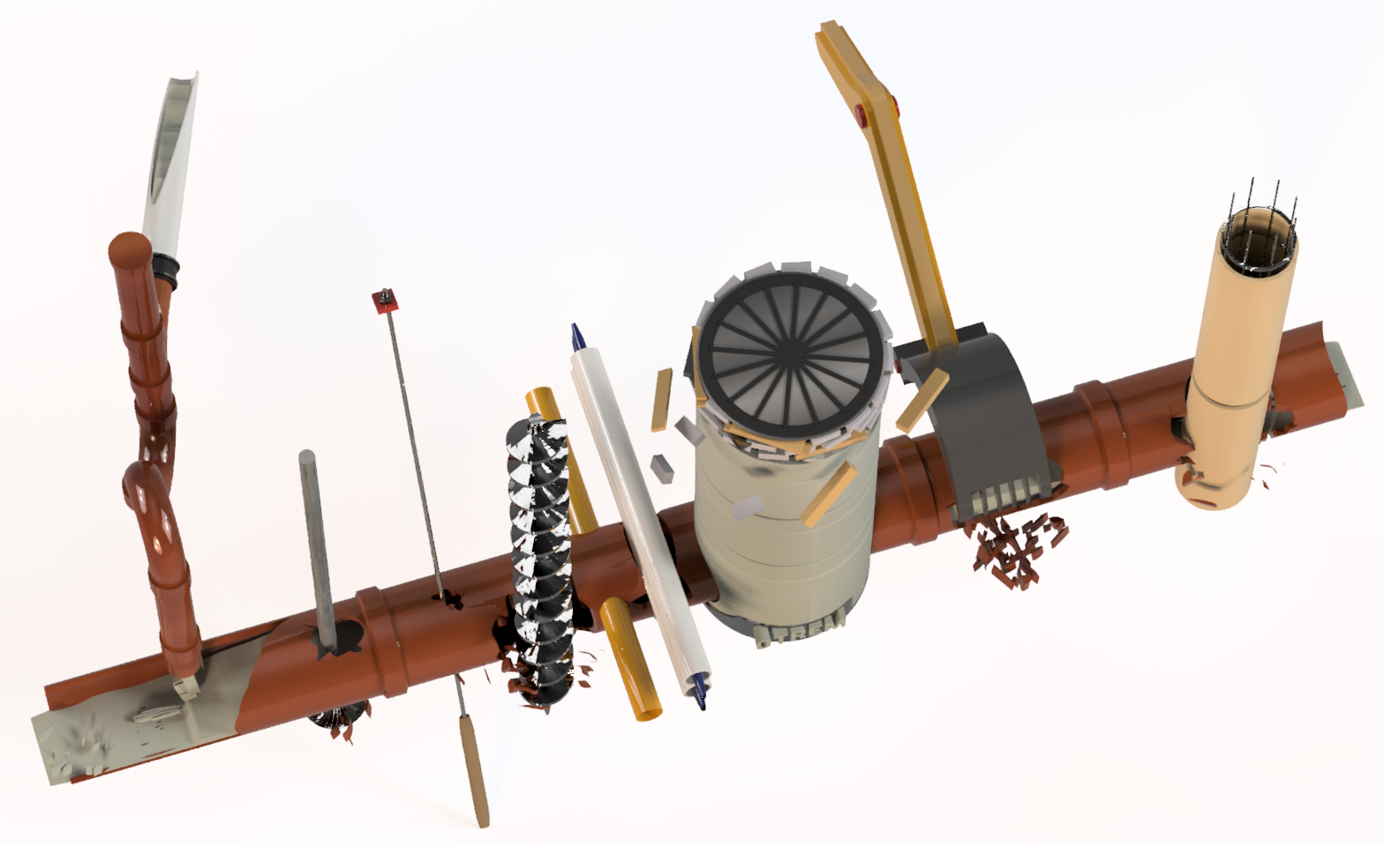
INTRODUCTION
Background on presenter
Presentation topic
Main causes of damages
Conclusion

Slide 4
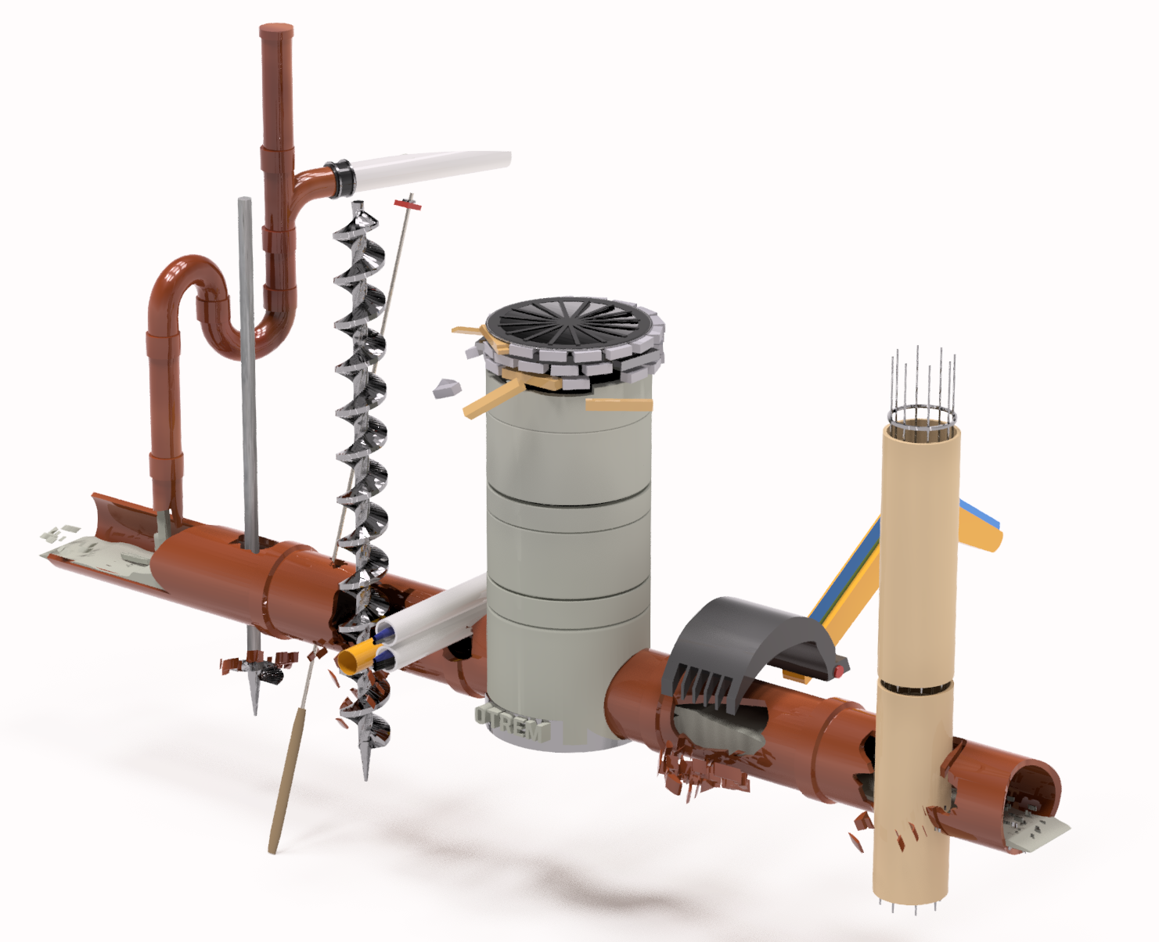
Background on presenter
Presentation topic
Main causes of damages
Conclusion

Slide 5
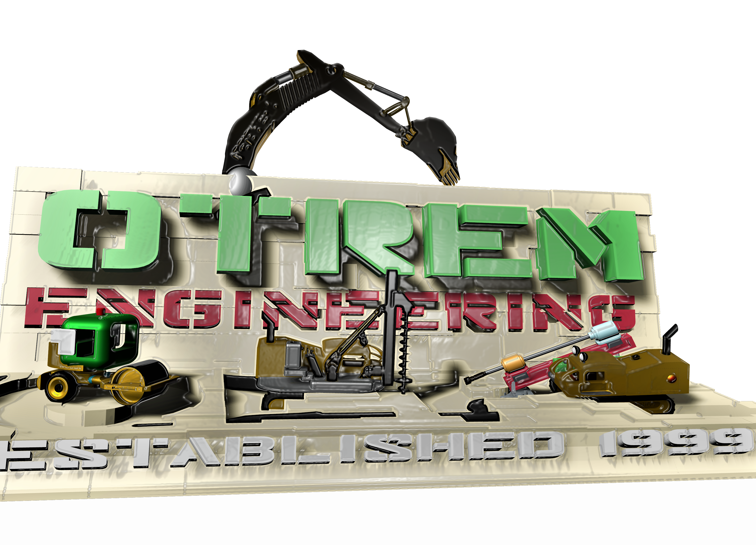
Background on presenter
Engineering consultancy for promoting the safe work around underground network since 1999.
Nationally and international public speaking on safe excavation near underground assets
Investigation and professional reporting on large and significant underground network damages
Working with the largest law firms to provide professional advice on underground asset damage cases in Australia
Involved in many training and writing of material for safe digging around services

Slide 6
Background on presenter
Presentation topic
Main causes of damages
Conclusion

Slide 7
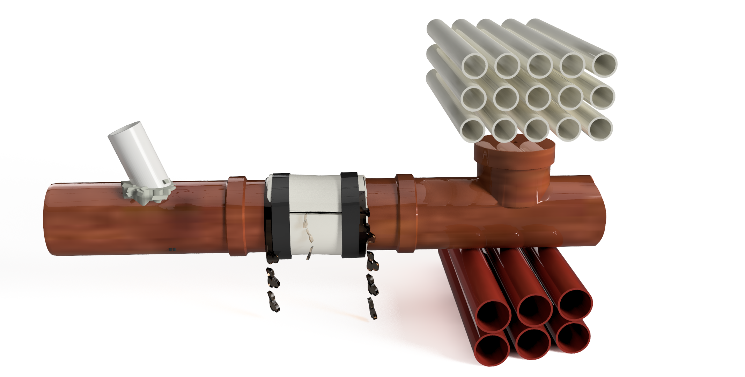
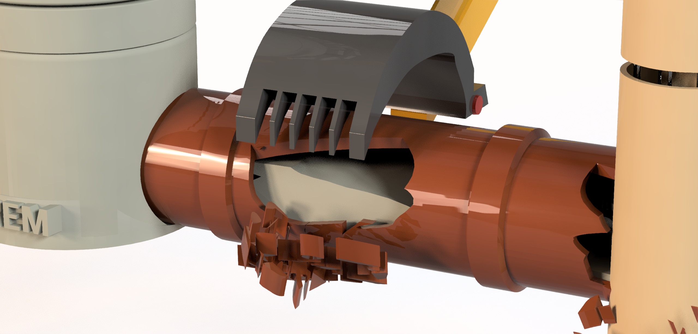
Presentation topic
Damages to major underground services in Australia in the last 3 years, based on:
Field investigations and
Legal cases.
Reasons of damages beyond the control of utilities!

Slide 8
Background on presenter
Presentation topic
Main causes of damages
Conclusion

Slide 9
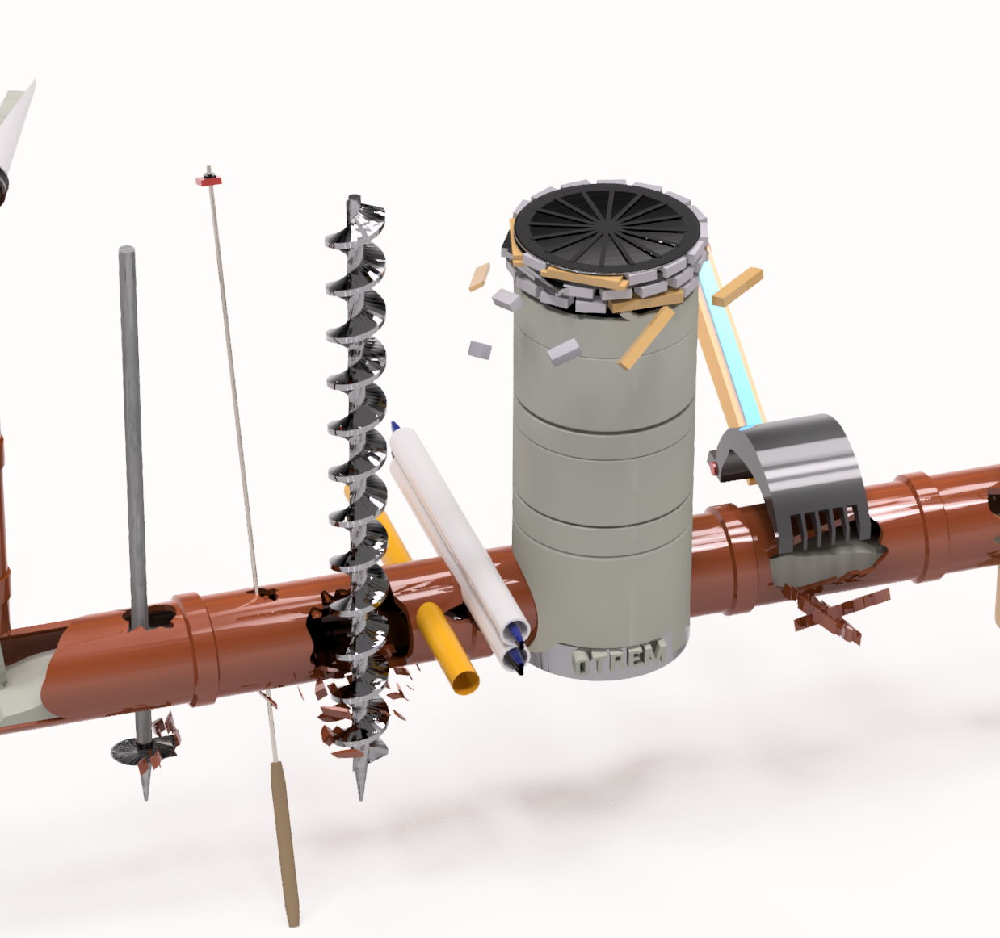
MAIN CAUSES OF DAMAGES
Concrete and Grout Injection
Drilling, Pilling and Auguring
Rock Anchors and Screw Piles
Excavations and Demolition
Unauthorised Works
Horizontal Directional Drilling

Slide 10
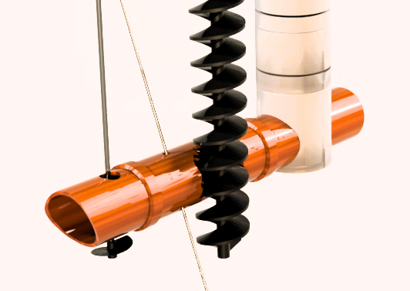
THE HITS ROLL ON!
From screw piles, to augurs, to rock anchors and everything in between.

Slide 11
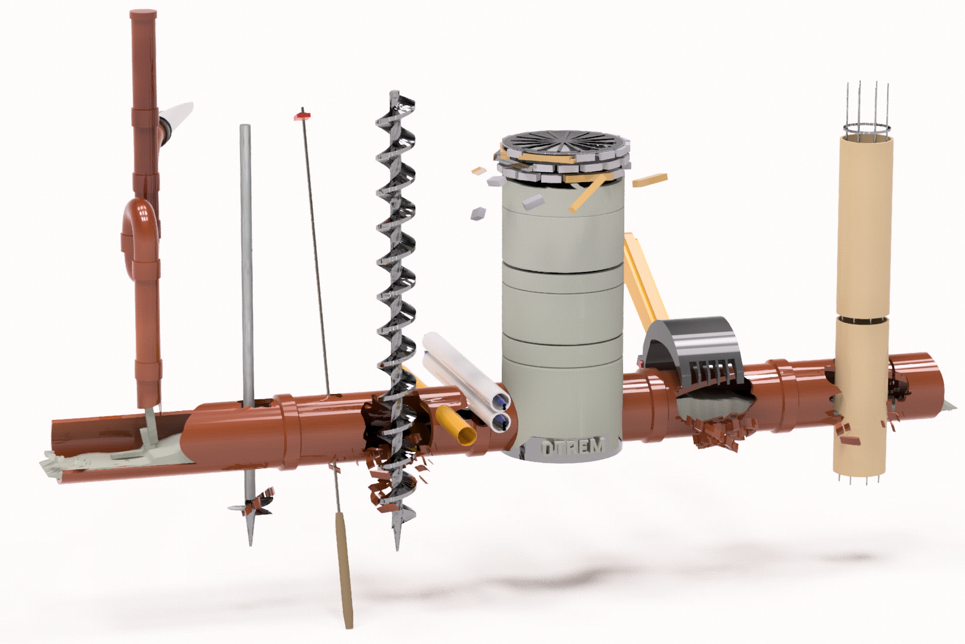
Augurs
Unauthorised Modifications
Piling
Concrete from Private Sewer &
Piers
Rock Anchors
Screw Piles
Trenching
HDD
Excavations
THE HITS ROLL ON….

Slide 12
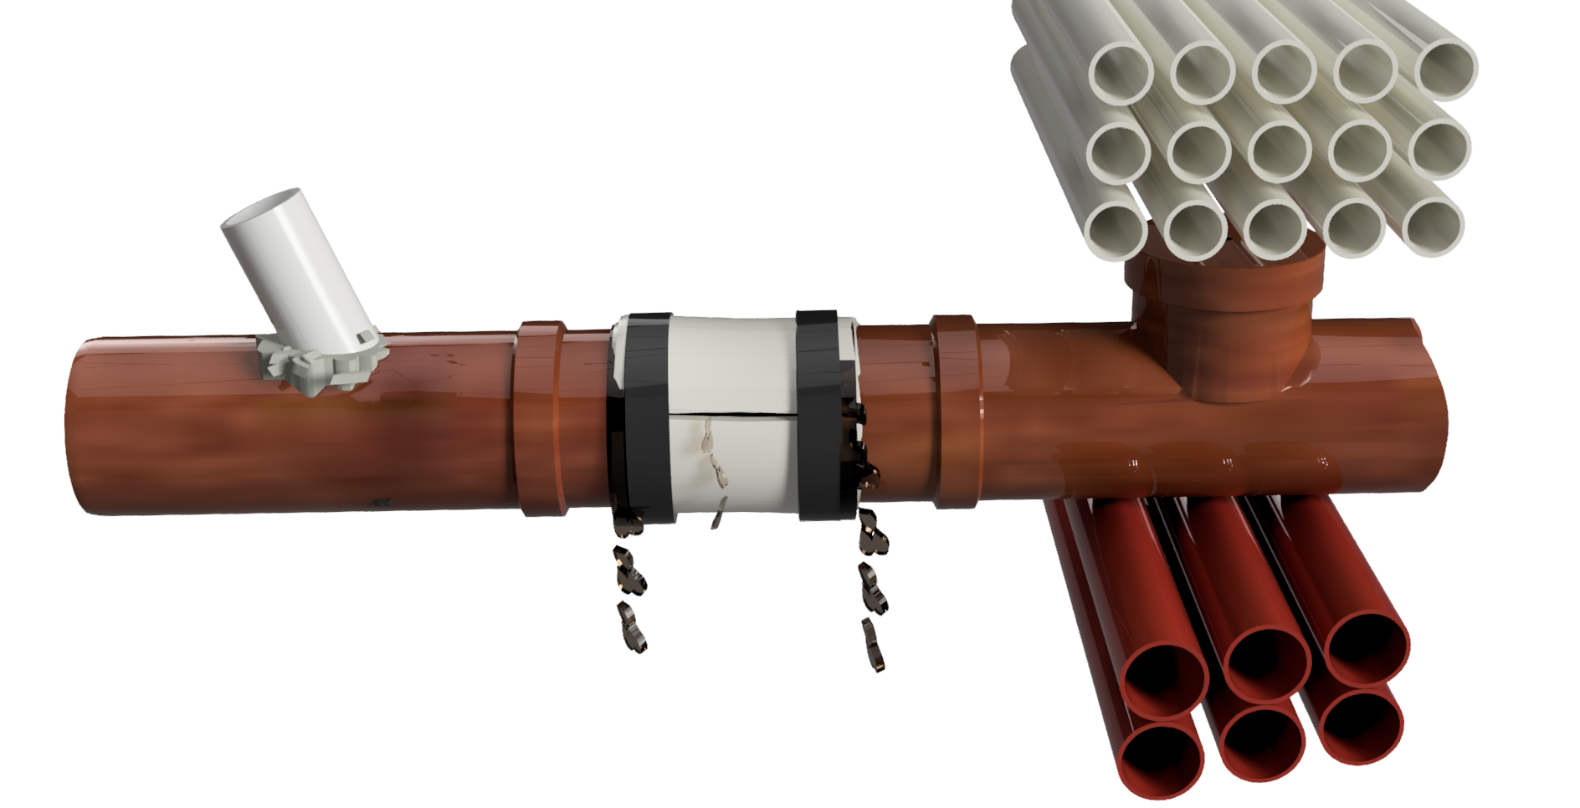
Unauthorised connections
Unauthorised repairs
Obstruction
Encroachment
THE HITS ROLL ON….

Slide 13
Background on presenter
Presentation topic
Main causes of damages
Conclusion

Slide 14
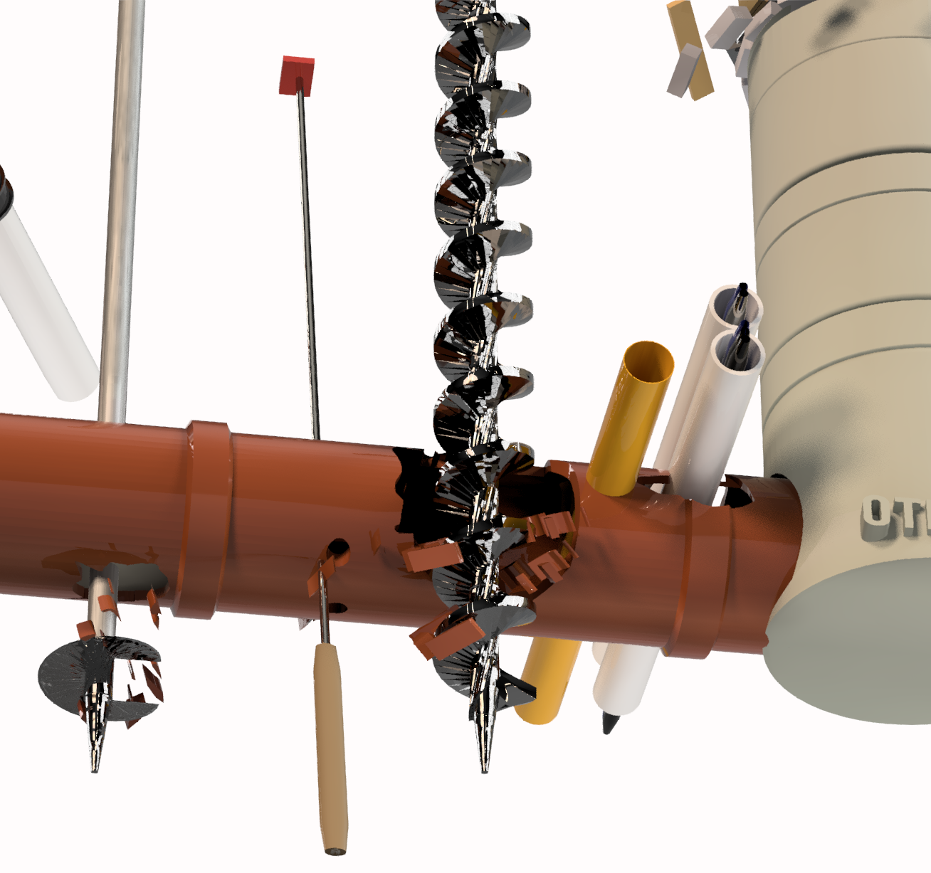
Conclusion
Explaining to developers they need to:
Accurately locate all assets
Report incidents to asset owners immediately
Report changes to your scope of works
Locate disused private wastewater pipes, sealing them at the sewer main
Encourage stricter oversight when auguring, piling, etc... and explain the consequences when they get it wrong.
Take plenty of photos to capture all the asset and general photos of site

Slide 15
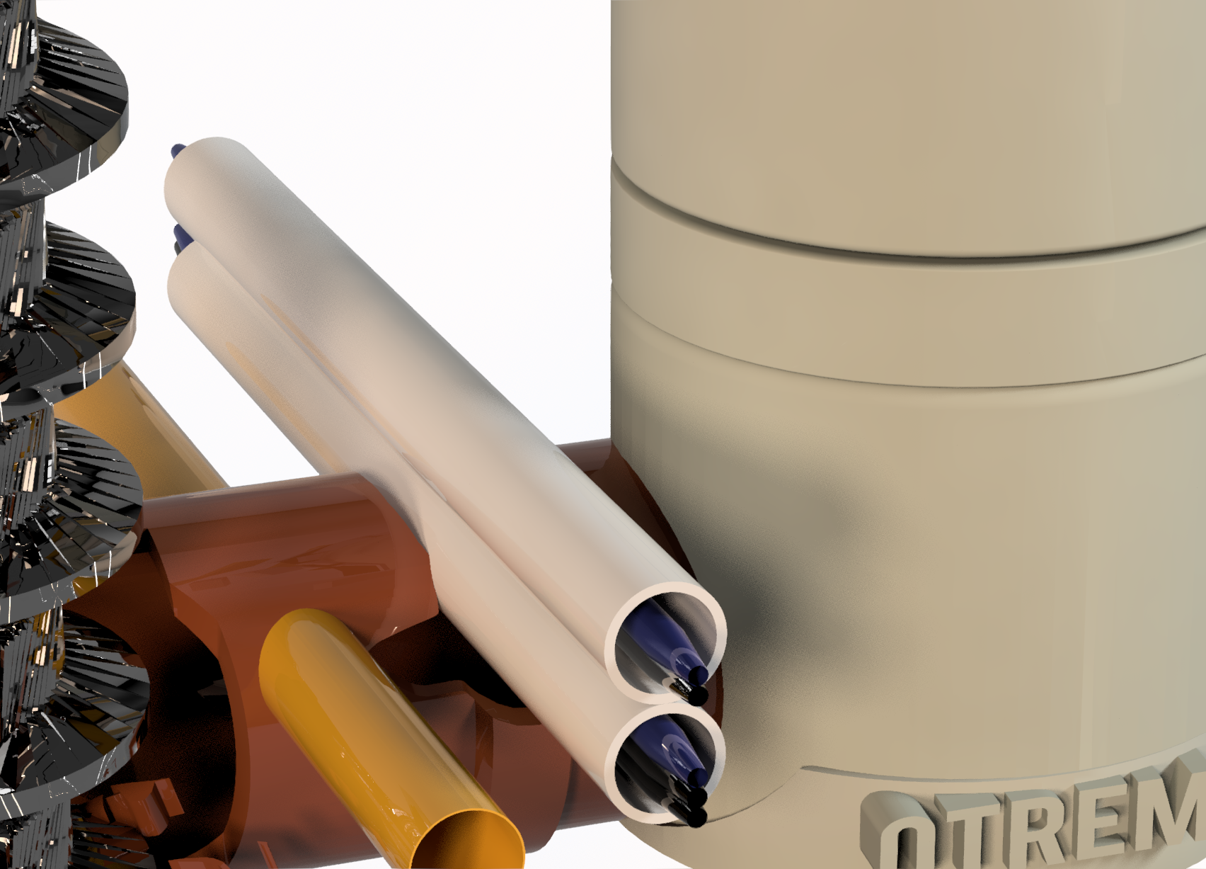
Summary
For most incidents, there was knowledge of the existence of the service that was impacted
Is there an opportunity that impactors are made aware of the potential damage beyond current controls (AI) ?

Slide 16
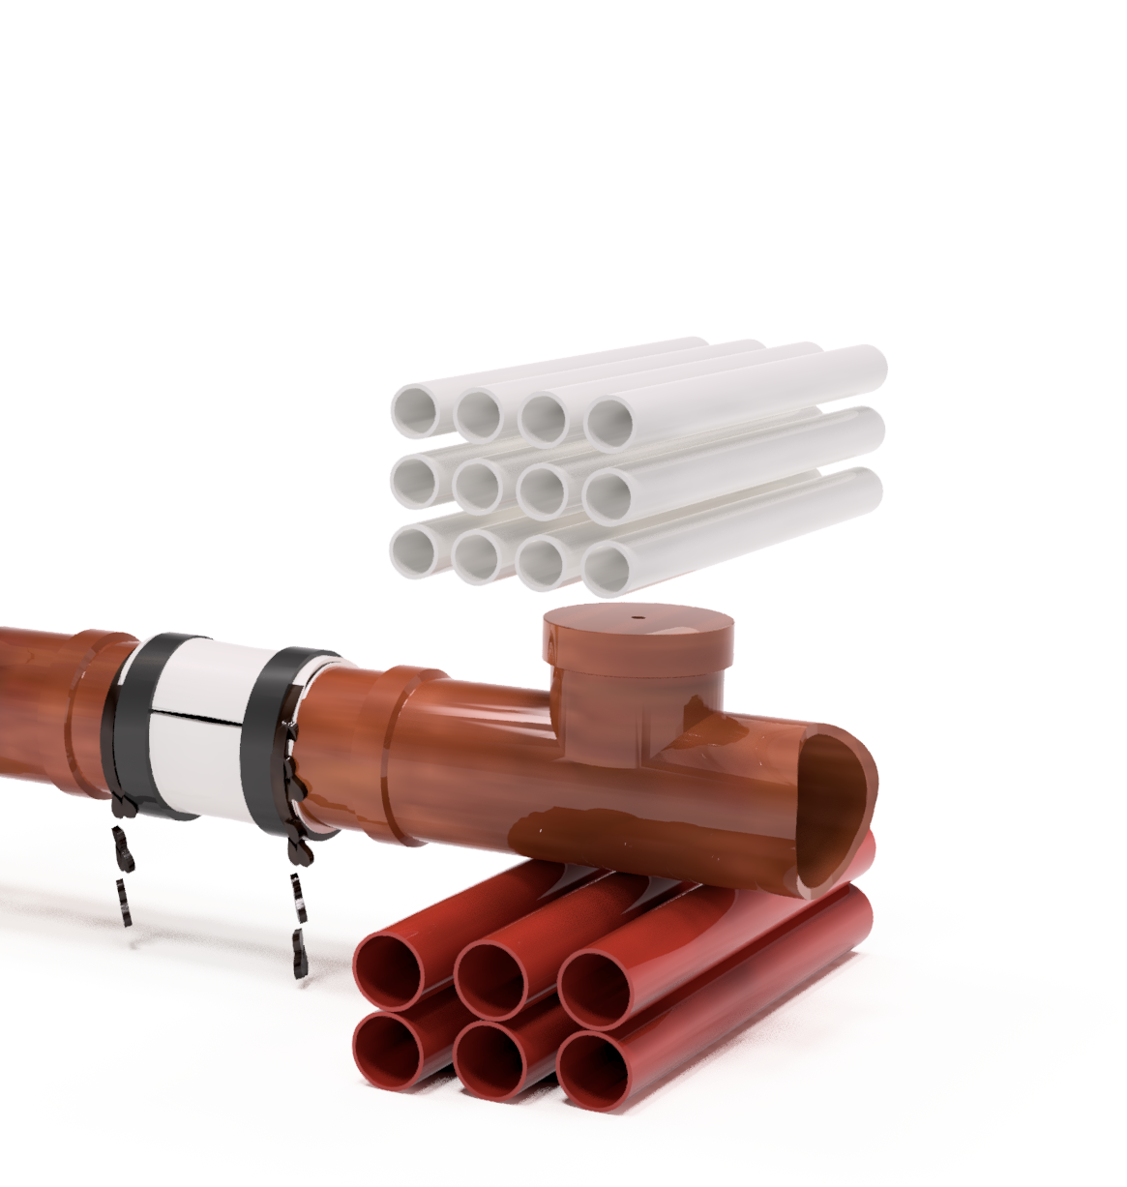
THANK YOU
info@otrem.com.au
Ph:+61491 291 100

Slide 17
  Please fill out your session survey via the mobile app!

Slide 18
  Save the Date!
  Nashville, TN
  August 18-20, 2026

